Slide 1
Details Project Report(DPR)
FLIGHT FARE PREDICTION
Submitted by :
Umesh Prajapati
Ramdas Prajapati

Slide 2
Contents
Abstract INTRODUCTION
Why this DPR Documentation?
Key points:
Description
Problem Perspective 1.2 Problem Statement 1.3 Proposed Solution
1.4 Solution Improvements 2 Technical Requirements
2.1 Tools Used
Data Requirements
Data Gathering from Main Source 3.2 Data Description
3.3 Import Data into Database 3.4 Export Data from Database
Data Pre-Processing
Design Flow 5.1 Modelling
UI Integration
Modelling Process 5.4 Deployment Process
Data from User
Data Validation
Rendering the Results 9 Deployment Conclusion
Q & A:
4
4
4
4
4
4
4
5
5
5
5
5
5
5
6
6
6
6
6
6
7
7
7
7
7
7
7
7

Slide 3
Abstract
The recent global situations had a huge impact on the aviation sector due to many reasons. This impact has two categories: the first is business perspective and the second is the customers perspective. As safety is the major reason for such impact on the aviation sector, the governments around the world amended different rules to their respective airlines companies. These restrictions had made the availability of the flights and their attendee capacity less. Taking all these factors in consideration the cost of the flight tickets has increased and varies from one place to the other. Booking a flight ticket has split into two, one is online and the other is the offline bookings. Both these have their respective criteria for cost of the ticket, one such example is the server load and the number of booking requests. In this machine learning implementation, we will see various factors that impact the cost of the flight ticket and predict the appropriate price of the ticket.
INTRODUCTION
Why this DPR Documentation?
The main purpose of this DPR documentation is to add the necessary details of the project and provide the description of the machine learning model and the written code. This also provides the detailed description on how the entire project has been designed end-to-end.
Key points:
Describes the design flow
Implementations
Software requirements
Architecture of the project
Non-functional attributes like:
Reusability
Portability
Resource utilization
1 Description
Problem Perspective
The flight fare prediction is a machine learning model which helps us to predict the cost of the flight ticket and helps the users to know the cost of their journey.
Problem Statement
The main goal of the project is to create a user interface which provides the cost of the flight ticket by taking certain input from the user like date of journey, onboard location and destination etc.
Proposed Solution
The solution proposed to take the required input of user from the created interface and process all the provided data to meet the requirements of the machine learning model and finally display the output saying so and so amount is the predicted cost.

Slide 4
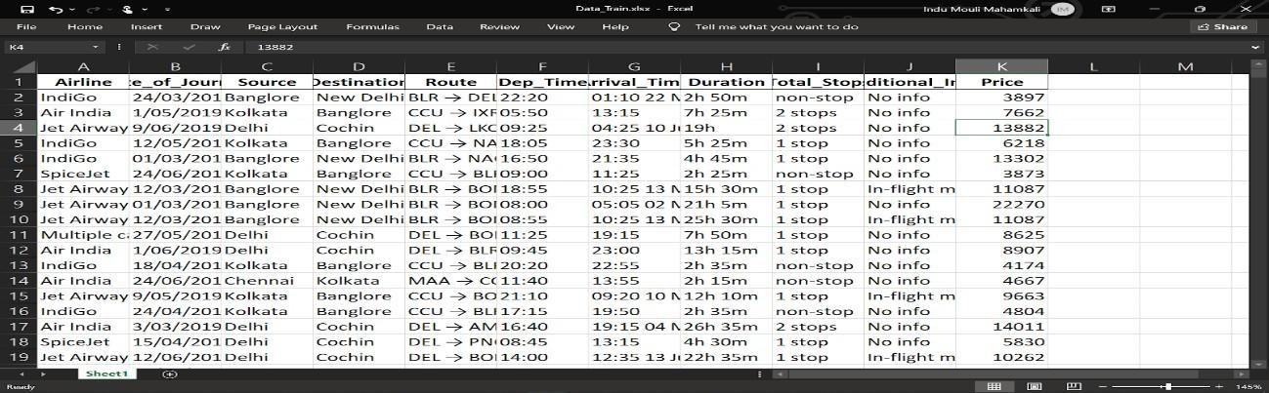
1.4 Solution Improvements
We can even predict the cost of ticket considering whether is it a weekday, holiday season or other social reasons. But considering from the perspective of business, if we process such data and predict the cost of the discounted ticket it will bring some loss to the airlines company. Hence this method is not considered.
Technical Requirements
There are no hardware requirements required for using this application, the user must have an interactive device which has access to the internet and must have the basic understanding of providing the input. And for the backend part the server must run all the software that is required for the processing the provided data and to display the results.
Tools Used
Python 3.9 is used as the programming language and frame works like numpy, pandas, sklearn and other modules for building the model.
PyCharm is used as IDE.
For visualizations seaborn and parts of matplotlib are being used.
For data collection Cassandra database is being used.
Front end development is done using HTML/CSS.
Flask is used for both data and backend deployment.
GitHub is used for version control.
Heroku is used for deployment.
Data Requirements
The data requirement is completely based on the problem statement. And the data set is available on the Kaggle in the form of excel sheet(.xlsx). As the main theme of the project is to get the experience of real time problems, we are again importing the data into the Cassandra data base and exporting it into csv format.
Data Gathering from Main Source
The data for the current project is being gathered from Kaggle dataset, the link to the data is: https://www.kaggle.com/nikhilmittal/flight-fare-prediction-mh
Data Description
There are about 10k+ records of flight information such as airlines, data of journey, source, destination, departure time, arrival time, duration, total stops, additional information, and price. A glance of the dataset is shown below:

Slide 5
Import Data into Database
Created an api for the upload of the data into the Cassandra database, steps performed are:
Connection is made with the database.
Created a database with name flight fare.
Cqlsh command is written for creating the data table with required parameters.
And finally, a cqlsh command is written for uploading the dataset into the data table by bulk insertion.
Export Data from Database
In the above created api, the download url is also being created, which downloads the data into a csv file format.
4 Data Pre-Processing
Steps performed in pre-processing are:
First the data types are being checked and found only the price column is of type integer.
Checked for null values as there are few null values, those rows are dropped.
Converted all the required columns into the date time format.
Performed one-hot encoding for the required columns.
Scaling is performed for required data.
And, the data is ready for passing to the machine learning algorithm.
Design Flow
Modeling
The pre-processed data is then visualized and all the required insights are being drawn. Although from the drawn insights, the data is randomly spread but still modeling is performed with different machine learning algorithms to make sure we cover all the possibilities. And finally, as expected random forest regression performed well and further hyperparameter tuning is done to increase the model’s accuracy.
UI Integration
Both CSS and HTML files are being created and are being integrated with the created machine learning model. All the required files are then integrated to the app.py file and tested locally.

Slide 6
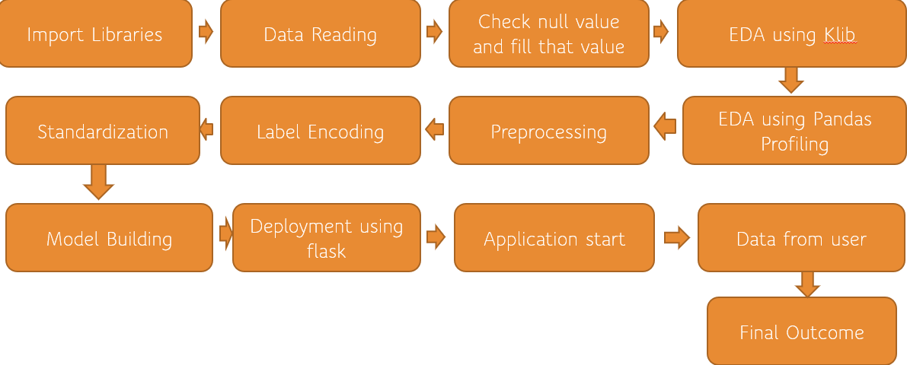
5.3 Modelling Process&5.4 Deployment Process
Data from User
The data from the user is retrieved from the created HTML web page.
Data Validation
The data provided by the user is then being processed by app.py file and validated. The validated data is then sent for the prediction.
Rendering the Results
The data sent for the prediction is then rendered to the web page.
Deployment
The tested model is then deployed to Heroku. So, users can access the project from any internet
devices.
Conclusion
The flight fare prediction can predict the price based on the trained data set in the algorithm.
Hence the user can know the approximate cost for their journey.
Q & A:
Q1) What’s the source of data?
The data for training is provided by the client in multiple batches and each batch contain multiple files.
Q 2) What was the type of data?
The data was the combination of numerical and Categorical values.

Slide 7
Q 3) What’s the complete flow you followed in this Project?
Refer Page no 6 for better Understanding.
Q 4) After the File validation what you do with incompatible file or files which didn’t pass the validation?
Files like these are moved to the Achieve Folder and a list of these files has been shared with the client and we removed the bad data folder.
Q 5) How logs are managed?
We are using different logs as per the steps that we follow in validation and modeling like File validation log, Data Insertion, Model Training log, prediction log etc.
Q 6) What techniques were you using for data pre-processing?
Removing unwanted attributes
Visualizing relation of independent variables with each other and output variables
Checking and changing Distribution of continuous values
Removing outliers
Cleaning data and imputing if null values are present.
●
Converting categorical data into numeric
values. Q 7) How training was done or what models were used?
Before dividing the data in the training and validation set, we performed pre-processing over the data set and made the final dataset.
As per the dataset training and validation data were divided.
Algorithms like Linear regression, SVM, Decision Tree, Random Forest, XGBoost were used based on the recall, final model was used on the dataset and we saved that model.
Q 8) How Prediction was done?
The testing files are shared by the client. We Performed the same life cycle on the provided dataset. Then, on the basis of the dataset, the model is loaded and prediction is performed. In the end we get the accumulated data of predictions.
Q 9) What are the different stages of deployment?
First, the scripts are stored on GitHub as a storage interface.
The model is first tested in the local environment.
After successful testing, it is deployed on Heroku.

